Slide 1
AI-Driven Crop Disease Prediction and Management System
CSE7101- Capstone Project
Review-1
Batch Number: ISE_6
Under the Supervision of,
Dr.Sivaramakrishnan S
Associate Professor
School of Computer Science and Engineering
Presidency University
Roll Number | Student Name
20221ISE0112 | Varun M J
20221ISE0147 | Nischal H Ameen
20221ISE0148 | Nitin Chitrakar
Name of the Program: B.Tech
Name of the HoD: Dr. Zafar Ali Khan N Name of the Program Project Coordinator: Ms. Suma N G
Name of the School Project Coordinators: Dr. Sampath A K , Dr. Geetha A

Slide 2
Problem Statement Number: PSCS_403
Organization: Presidency University
Category : Software
Problem Description:
Traditionally, farmers rely on manual inspection and expert advice to diagnose leaf diseases, but this method is time-consuming, not always accessible—especially in rural areas—and prone to errors since early symptoms can be hard to distinguish. As apple cultivation expands and disease outbreaks become more frequent, there is an urgent need for a solution that is accurate, fast, and easy to use by anyone, even without scientific knowledge. Such a solution would help farmers detect diseases early, protect their crops, and improve their livelihoods.

Slide 3
Content
Problem Statement
Objectives
Background and Related work for title Selection
Analysis of Problem Statement
Innovation or Novel Contributions
Git-hub Link
Timeline of the Project
References

Slide 4
Content
Problem Statement
Farmers face significant challenges in accurately and quickly diagnosing apple leaf diseases due to reliance on manual inspection and limited access to expert advice, leading to delayed treatment and reduced crop yields. There is a need for an accessible, precise, and fast solution that can automatically detect and identify apple leaf diseases to help farmers protect their crops effectively.
Objectives
Develop a robust Convolutional Neural Network (CNN) model capable of accurately detecting and classifying apple leaf diseases such as black rot, cedar rust, and scab, as well as identifying healthy leaves.
Combine multiple publicly available datasets to improve the accuracy and generalization of the disease prediction model.
Create an intuitive and responsive web application that allows users to upload apple leaf images and receive real-time disease diagnosis.
Integrate an interactive chatbot to assist users by answering common questions related to apple leaf diseases, symptoms, and management practices.
Provide actionable disease management recommendations to help farmers take timely and effective preventive or corrective measures.

Slide 5
Analysis of Problem Statement
Technology Stack Components:
Data Collection & Preprocessing
Datasets: Use Apple Leaf Diseases Dataset from Kaggle and other open-source datasets for broad coverage.
Image Processing: Libraries like OpenCV or PIL for resizing, augmenting, and cleaning images.
Model Development
Deep Learning Framework: TensorFlow/Keras or PyTorch for designing and training Convolutional Neural Networks (CNNs).
CNN Architectures: Use pre-built models like ResNet, EfficientNet, or custom lightweight CNNs suitable for leaf disease classification.
Data Augmentation: Techniques implemented via TensorFlow ImageDataGenerator or Albumentations to increase dataset variety and reduce overfitting.
Backend Development
Server Framework: Flask or FastAPI (Python) to create APIs for image upload and prediction.
Model Serving: TensorFlow Serving or TorchServe for scalable and efficient deployment of trained models.
Frontend Development
Web Framework: React.js, Angular, or Vue.js for building a user-friendly web interface allowing image upload and displaying results.
Responsive Design: Ensure compatibility across mobile and desktop.
Chatbot Integration
NLP Frameworks: Dialogflow, Rasa, or leveraging ChatGPT API to create a chatbot for answering disease-related queries.
Knowledge Base: Curated FAQs and disease management info for chatbot training.

Slide 6
Analysis of Problem Statement (contd...)
Software Requirements:
Programming Languages : Python, JavaScript
Development Tools : Visual Studio Code, Jupyter Notebook
Machine Learning Frameworks & Libraries : TensorFlow ,PyTorch, Keras ,NumPy, Pandas
Backend Framework : Flask
Frontend Framework : React.js, Angular
Database : PostgreSQL,MySql
Version Control :Git and GitHub

Slide 7
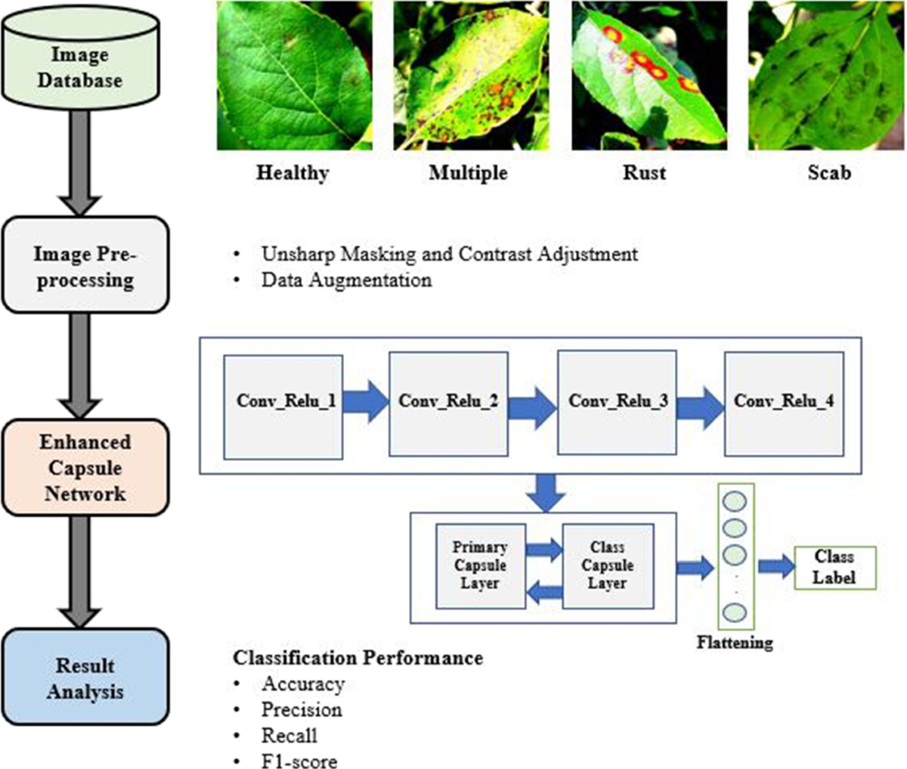
Analysis of Problem Statement (contd...)

Slide 8
Github Link
Github Link :
https://github.com/Nischalh777/Capstone_Project_ISE_6-

Slide 9
Timeline of the Project
Review 1
Problem statement objectives.
Review 2
Basic ML model skin disease classification.
Review 3
Fully functional dynamic website.
Datasets proposed methodology.
Project objective and scope documentation.
Initial presentation of approach and planned tech stack.
Host the model on server backend.
Create a simple web interface where users can upload an image.
Working demo of model prediction via web page.
Deploy the Website on a cloud platform.
Final presentation/demo
Detailed Prediction reports, probability score and disease information.

Slide 10
References (IEEE Paper format)
[1]. Pankaj Kumar, Om Pailwan, Jadhav Milan Bhausaheb, and Prof. Pallavi Bhaskare, “Leaf Disease Detection Using Image Processing,” Int. J. Adv. Res. Sci. Commun. Technol., vol. 6, no. 1, pp. 667–673, 2022, doi: 10.48175/ijarsct-3993.
[2]M. U. Ahmad, S. Ashiq, G. Badshah, A. H. Khan, and M. Hussain, “Feature Extraction of Plant Leaf Using Deep Learning,” Complexity, vol. 2022, 2022, doi: 10.1155/2022/6976112.

Slide 11


